Slide 1
AtilQ Hospitality Analysis
Project Report By
Ruchita Patel

Slide 2
Problem Statement
Atliq Grands owns multiple five-star hotels across India. They have been in the hospitality industry for the past 20 years. Due to strategic moves from other competitors and ineffective decision-making in management, Atliq Grands are losing its market share and revenue in the luxury/business hotels category. As a strategic move, the managing director of Atliq Grands wanted to incorporate “Business and Data Intelligence” in order to regain their market share and revenue. However, they do not have an in-house data analytics team to provide them with these insights. Their revenue management team had decided to hire a 3rd party service provider to provide them with insights from their historical data.

Slide 3
Case Studied
City wise Revenue Generated, Average Rating and Hotel Category
Property Name wise Avg Rating, Occupancy, Revenue generated, Successful Bookings
Trends by Week
Booking % by platform
Filters by Month and Week

Slide 4
Approaches
Python: Used for Data Cleaning
Tableau: Used for creating Dashboards and Story - https://tinyurl.com/ycyau3d7

Slide 5
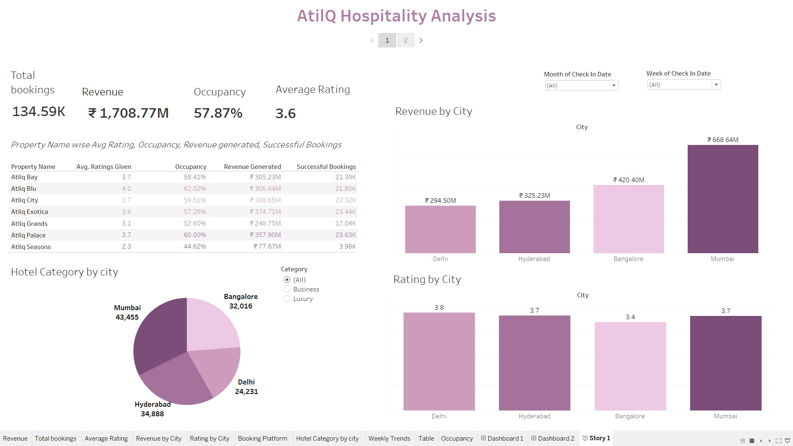
My Design

Slide 6
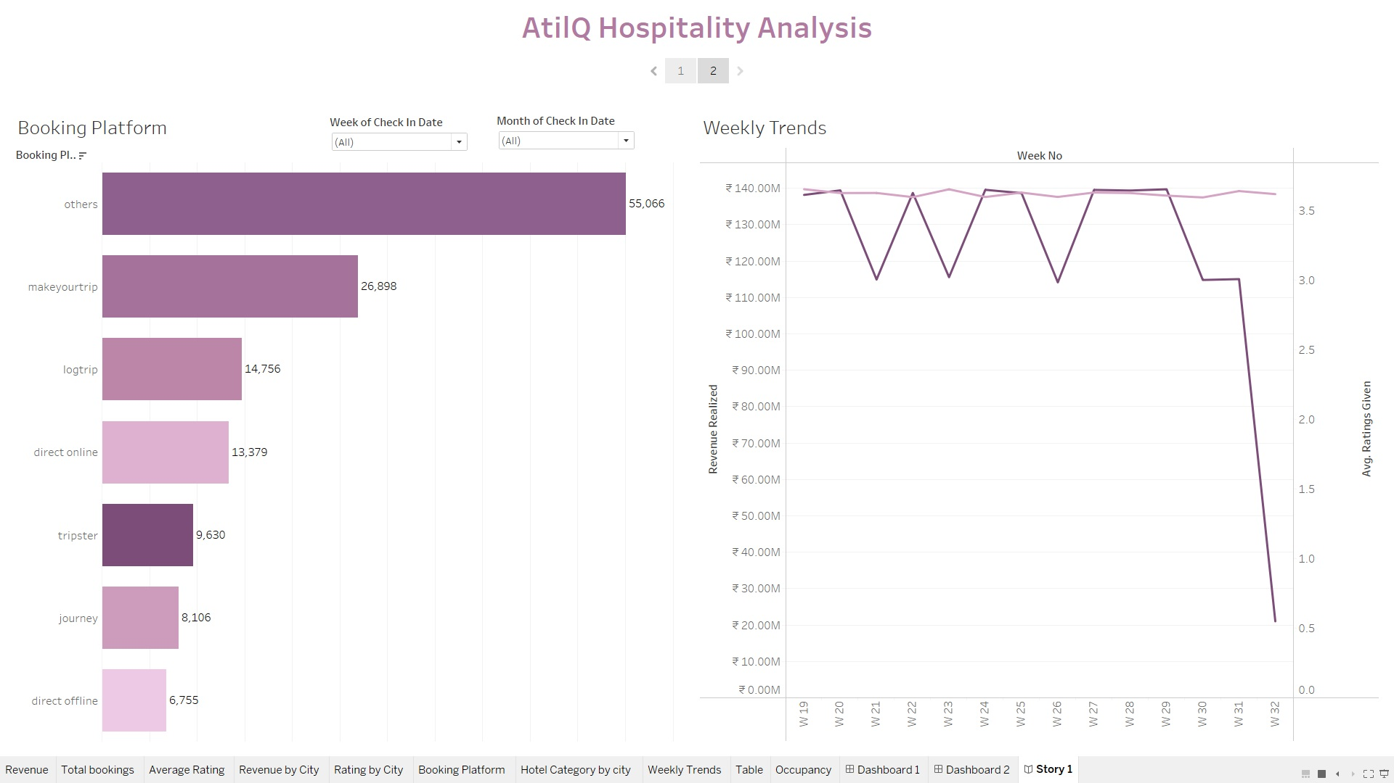
My Design

Slide 7
Thank You

